Slide 1
Is there a teacher recruitment and retention crisis in Wales?
The EWC view

Slide 2
Overview
Profile (slides 1-4)
Recruitment (slide 5)
    New teachers (slides 6 – 13)
    Headteachers (slides 14 - 15)
    Welsh language (slide 16)
    Secondary subjects (slide 17)
  Retention (slides 18 - 21)
  What's happening elsewhere? (slides 22 – 23)
  Factors to consider (slides 24)
  Moving forward (slides 25 – 26)

Slide 3
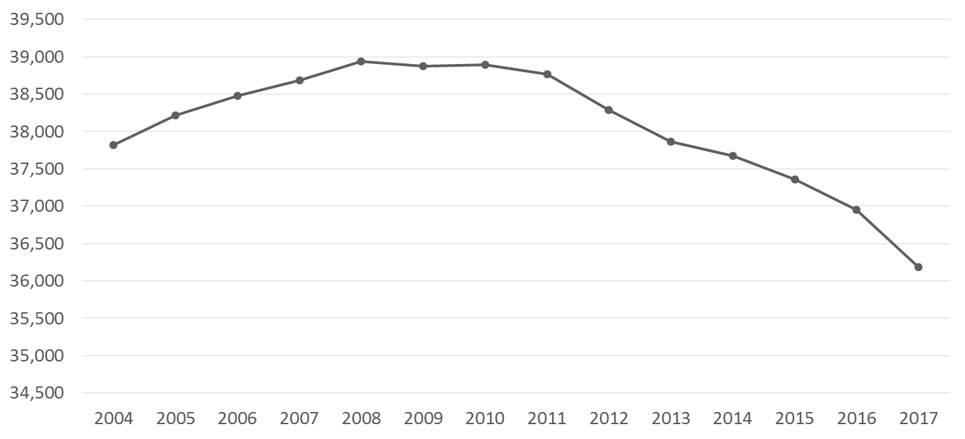
School teacher registration
36,182
Source: EWC (based on data taken on 1 March each year)
The 2017 figure ,31,182 is based upon primary registration category. An additional 244 practitioners are registered in one or more of the other registration categories.

Slide 4
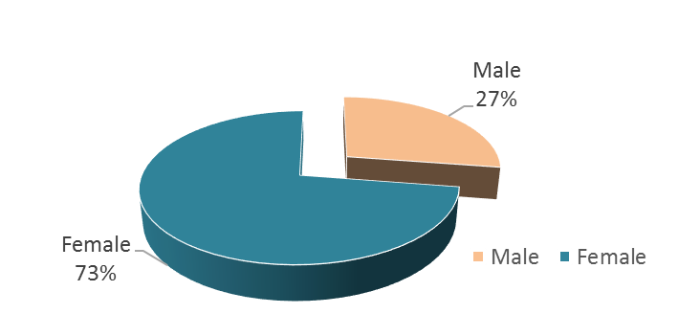
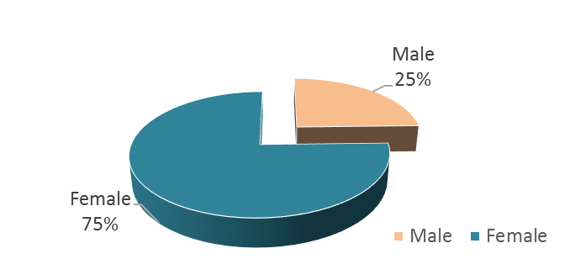
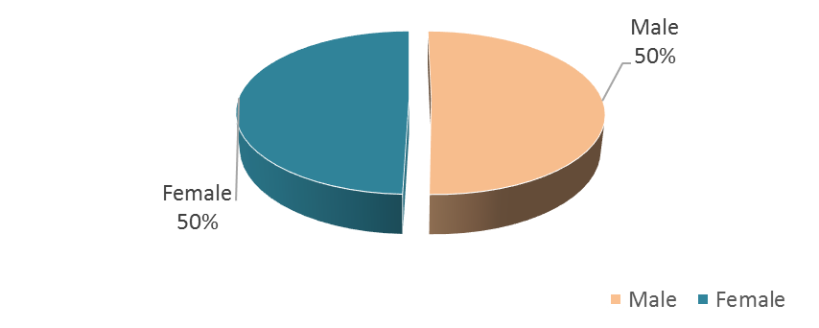
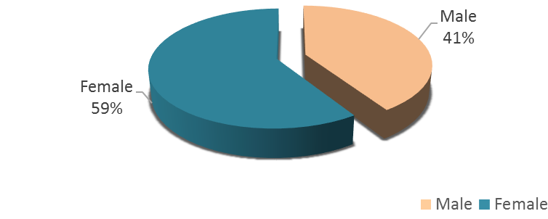
March 2003
March 2017
Gender balance of all registered school teachers
Gender balance of headteachers
Source: EWC

Slide 5
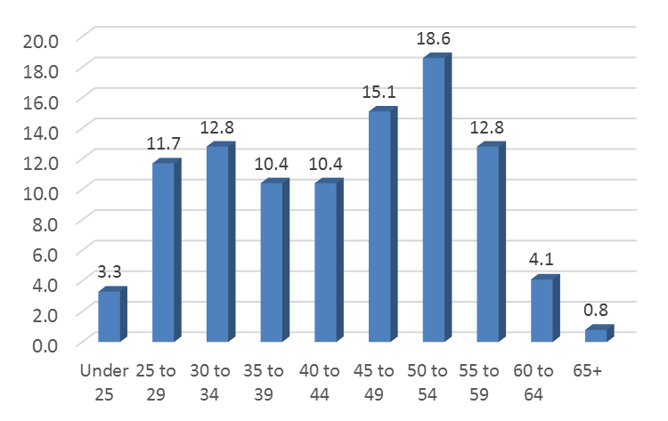
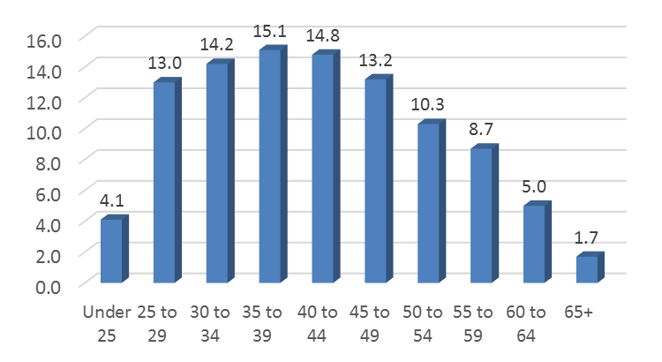
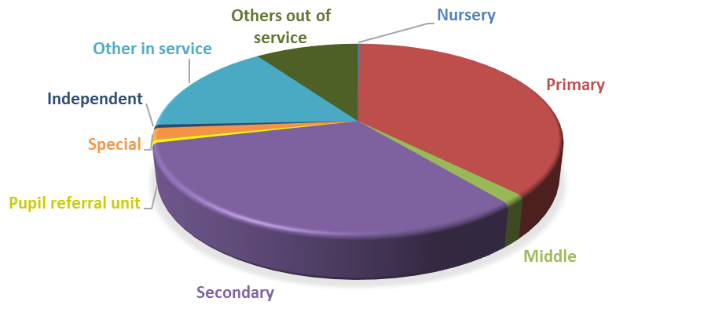
March 2003
March 2017
Age profile of registered school teachers (%)
Phase profile of registered school teachers - March 2017
Source: EWC

Slide 6
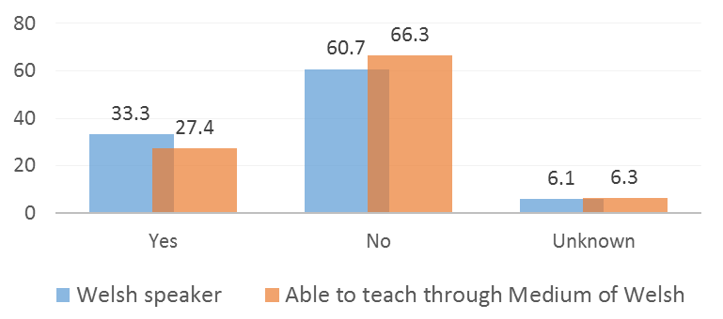
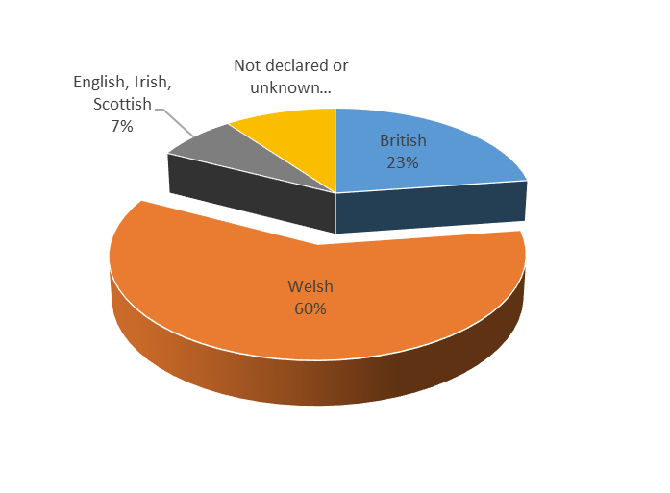
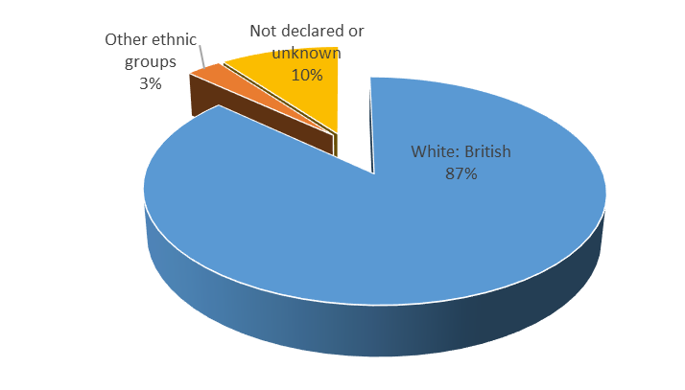
Welsh language
Declaration made regarding disability in accordance with the Equality Act 2010
Yes: 0.2%
No: 99.8%
National identity
Ethnic group
Source: EWC

Slide 7
Recruitment
New teachers
Headteachers
Secondary subjects
Welsh language

Slide 8
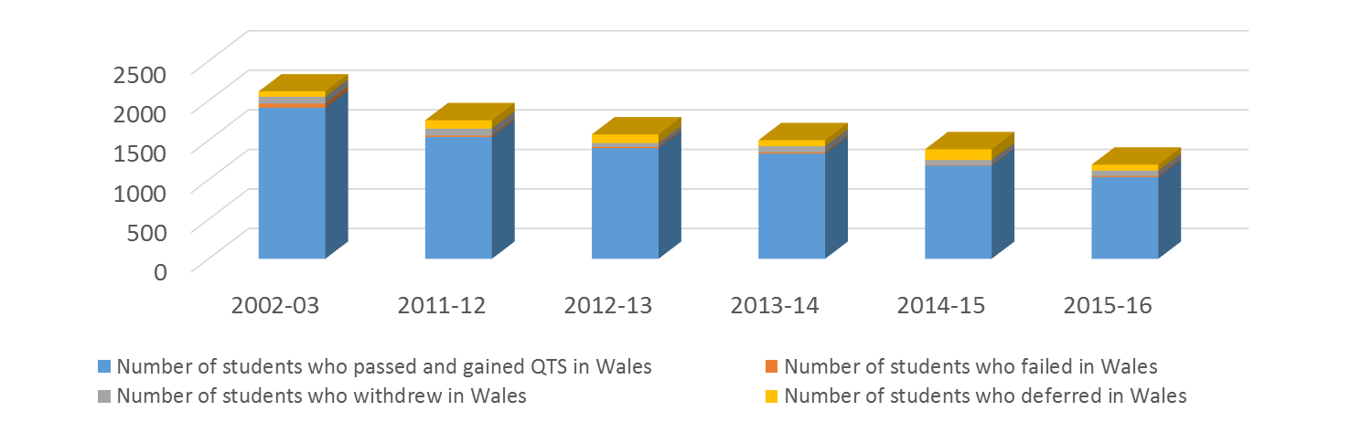
Initial teacher education
ITET student results (Wales)
ITET student results (Wales) – academic year 2015-2016 by phase
 | Number of Undergraduate Primary students | Number of Undergraduate Secondary students | Number of Postgraduate Primary students | Number of Postgraduate Secondary students | Total
Failed | 7 | 4 | 0 | 4 | 15
Withdrawn | 3 | 0 | 15 | 47 | 65
Deferred | 11 | 2 | 34 | 30 | 77
Total | 21 | 6 | 49 | 81 | 157
Source: EWC

Slide 9
Analysis of Induction starters 2015/2016
Data taken on 24/04/2017 and relates to the first record in the Professional Development section of the Register for all teachers who began induction between 01/09/2015 and 31/08/2016
Route | Permanent | Temporary | Supply | Blank | Total
Employed | 143 | 646 | 54 | 46 | 889
Supply | n/a | n/a | n/a | n/a | 315
The employment details for the teachers in the employed category:
 | Permanent | Temporary | Supply
Full-Time | 120 | 544 | 41
Part-Time | 8 | 71 | 8
Not recorded | 15 | 31 | 5
Of the teachers who began induction during the school year 2015-16, the following amount have passed to date:
Route | Total
Permanent | 133
Temporary | 523
Employed - Supply | 36
Short Term Supply | 94
The majority of newly qualified teachers complete their induction period in more than one institution.
58.1% of supply teachers are either NQTs or teachers at the end of their careers.
Source: EWC

Slide 10
College Exit | 2002 - 2003 | 2011 - 2012 | 2012 - 2013 | 2013 -2014 | 2014 - 2015 | 2015 - 2016
 | Number of teachers | Number of teachers | Number of teachers | Number of teachers | Number of teachers | Number of teachers
Number gained QTS | 1,910 | 1,539 | 1,398 | 1,329 | 1,177 | 1,033
Number registered with EWC (previously GTCW) on the 1 March following the award of QTS | 1,356 | 1,160 | 1,061 | 995 | 893 | 811
Induction
3 terms (minimum requirement) | 827 (61.0%) | 479 (41.3%) | 468 (44.1%) | 416 (41.8%) | 418 (46.8%) | 0
4 to 6 terms | 220 (16.2%) | 347 (29.9%) | 334 (31.5%) | 368 (37.0%) | 175 (19.6%) | 0
7 to 9 terms | 33 (2.4%) | 53 (4.6%) | 36 (3.4%) | 11 (1.1%) | 1 (0.1%) | 0
10 to 12 terms | 6 (0.4%) | 10 (0.9%) | 4 (0.4%) | 0 (0.0%) | 0 (0.0%) | 0
13 terms or more | 6 (0.4%) | 0 (0.0%) | 0 (0.0%) | 0 (0.0%) | 0 (0.0%) | 0
Passed induction in England | 36 (2.7%) | 28 (2.4%) | 12 (1.1%) | 5 (0.5%) | 1 (0.1%) | 0
Failed to meet the Practising Teacher Standards standards | 1 (0.1%) | 0 (0.0%) | 1 (0.1%) | 0 (0.0%) | 0 (0.0%) | 0
Not yet completed induction (may have completed elsewhere) | 227 (16.7%) | 243 (20.9%) | 206 (19.4%) | 195 (19.6%) | 298 (33.4%) | 811 (100%)
Registered March 2017 | 912 | 864 | 864 | 894 | 824 | 811
Source: EWC

Slide 11
Recruitment to target
  The requirement for trainees to hold a B grade in Mathematics and English
  Better financial incentives to train as a school teacher in England
  Difficulties in obtaining permanent posts in Wales. Note, EWC data shows that over 80% of new teachers in Wales have fixed term contracts or supply work
  Negative publicity about the quality of training in Wales
  Annual student feedback - perception that the career is getting harder and that the profession is unattractive
  Fewer people from outside Wales are training in Wales
  Perceived workload and administration

Slide 12
Other routes within Wales
Teach First Cymru
Academic year | Number of teachers | Registered as a school teacher as at 1 March 2017
2013 to 2014 | 25 | 7
2014 to 2015 | 30 | 28
2015 to 2016 | 50 | 48
Total | 105 | 83*
*No employment held - 20
Graduate Teacher Programme (Wales)
Academic year | Number of teachers | Registered as a school teacher as at 1 March 2017
Prior to 2013 | 481 | 341
2013 to 2014 | 50 | 43
2014 to 2015 | 51 | 48
2015 to 2016 | 54 | 51
2016 to 2017 | 40 | 36
From 1 April 2017 | 3 | 3
Total | 679 | 522*
*No employment held - 31
Not registered as a school teacher registered in another category: 1 Teach First and 18 GTP
Returning to practice scheme – criteria met | 1 April 2014 to 31 March 2017
Applications as a registered school teacher | 151
Source: EWC

Slide 13
Qualified teachers from outside Wales teaching in Wales
Award of QTS (other routes) as the GTCW until 31 March 2015 and as the EWC from 1 April 2015 (last 5 years)
1 April to 31 March | EEA – QTS Awarded | EEA QTS Not Awarded | Northern Ireland – QTS Awarded | Northern Ireland – QTS Not Awarded | Scotland – QTS Awarded | Scotland – QTS Not Awarded
2012 to 2013 | 57 | 21 | 0 | 0 | 2 | 1
2013 to 2014 | 65 | 31 | 0 | 0 | 8 | 1
2014 to 2015 | 55 | 21 | 1 | 0 | 3 | 1
2015 to 2016 | 24 | 18 | 0 | 0 | 0 | 0
2016 to 2017 | 17 | 11 | 0 | 1 | 2 | 2
Applications for recognition under the European Directive by Country between 1 April 2016 and 31 March 2017
Country | Award | Decline | Number of Applications
Poland | 3 | 5 | 8
Spain | 4 | 2 | 6
Germany | 3 | 0 | 3
Greece | 1 | 1 | 2
Lithuania | 1 | 1 | 2
Austria | 1 | 0 | 1
Bulgaria | 1 | 0 | 1
France | 1 | 0 | 1
Italy | 0 | 1 | 1
Netherlands | 0 | 1 | 1
Romania | 1 | 0 | 1
EEA | 1 | 0 | 1
Total | 17 | 11 | 28
Source: EWC

Slide 14
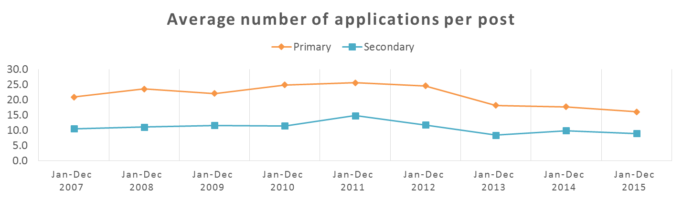
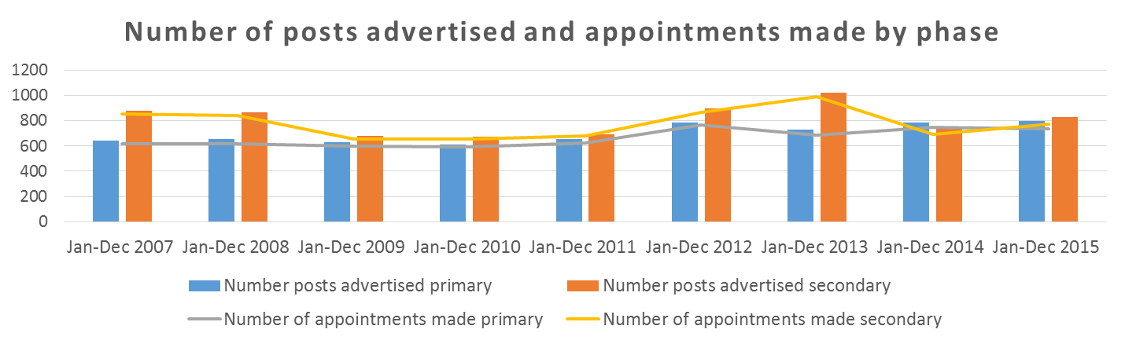
Employment challenges
Source: Stats Wales

Slide 15
Fail to meet the QTS standards | Fail to meet the Practising Teacher Standards | Fitness to practise
At the end of their course of ITT in Wales year on year | Statutory induction has been a requirement in Wales since 2003 | Serious professional incompetence | Combination of conduct and competence
Around 1% | 0.07% (10 fails out of 15,355) | 27 | 5
Source: EWC

Slide 16
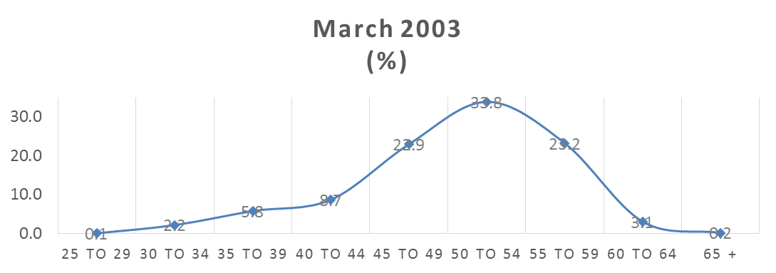
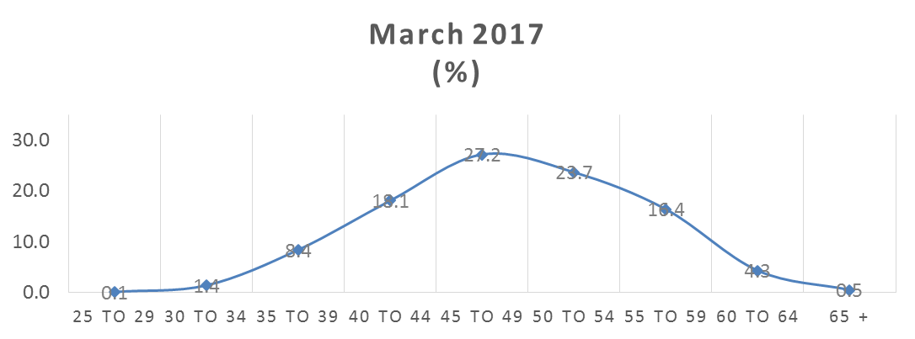
Headteachers
Year of NPQH award | Number registered March 2017
1999 | 12
2000 | 28
2001 | 48
2002 | 49
2003 | 161
2004 | 125
2005 | 151
2006 | 122
2007 | 129
2008 | 128
2009 | 156
2010 | 139
2011 | 209
2012 | 69
2013 | 73
2014 | 68
2015 | 108
Total | 1,775
Age profile of headteachers
Registered teachers as at March 2017 awarded NPQH not in a headteacher role | Number of teachers
Assistant headteacher | 85
Deputy head | 271
Head of department | 8
Head of year | 1
Senior teacher | 7
Teacher | 148
Others in-service | 70
Others out of service | 152
Total | 742
Source: EWC

Slide 17
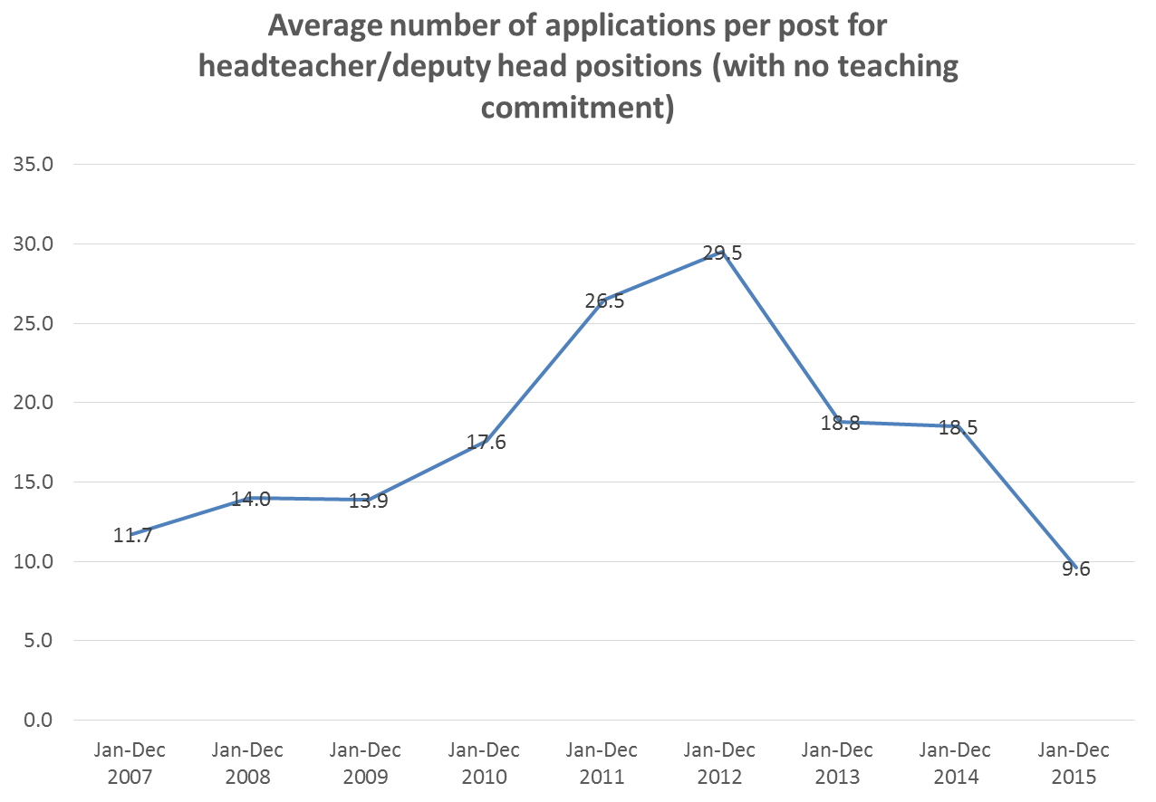
Source: Stats Wales

Slide 18
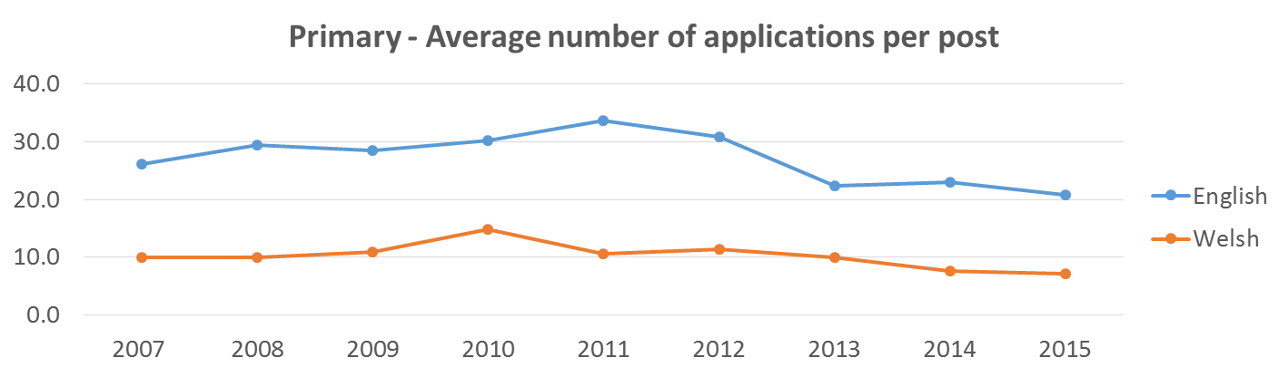
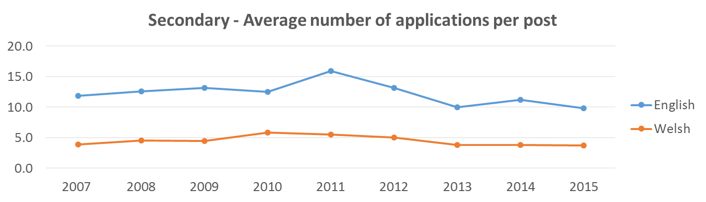
Welsh language
Source: Stats Wales
19.0% able to speak Welsh in Wales, 2011 Census

Slide 19
Subject taught versus subject trained
Core subjects & religious education
 | 1 March 2016
 | Number trained in subject | Percentage (%) | Number not trained in subject | Percentage (%) | Subject trained is unknown | Percentage (%) | Total teaching subject | Percentage (%)
Biology | 250 | 58.5 | 164 | 38.4 | 13 | 3 | 427 | 100%
Chemistry | 221 | 52.7 | 181 | 43.2 | 17 | 4.1 | 419 | 100%
English | 1,179 | 73.7 | 319 | 19.9 | 101 | 6.3 | 1,599 | 100%
Mathematics | 1,188 | 77.6 | 265 | 17.3 | 77 | 5 | 1,530 | 100%
Physics | 162 | 44.1 | 189 | 51.5 | 16 | 4.4 | 367 | 100%
Religious education | 386 | 66.1 | 158 | 27.1 | 40 | 6.8 | 584 | 100%
Science | 352 | 30.6 | 752 | 65.3 | 47 | 4.1 | 1,151 | 100%
Welsh | 717 | 71.4 | 232 | 23.1 | 55 | 5.5 | 1,004 | 100%
Source: EWC

Slide 20
Retention: 10 year school teacher tracking analysis
1,965 gained QTS during the 2005/06 college exit initial notification.
952 (48.4%) are not currently registered as school teachers with the EWC. The others are summarised below:
1 March 2017
Gained QTS during the 2005/06 college exit | Nursery and primary | Middle | Secondary | Special, independent, others in and out of service | Total
Headteacher | 5 | 0 | 0 | 0 | 5
Assistant headteacher | 3 | 0 | 11 | 1 | 15
Deputy head | 28 | 0 | 1 | 2 | 31
Head of department | 1 | 0 | 17 | 0 | 18
Head of year | 0 | 0 | 1 | 0 | 1
Teacher | 410 | 17 | 339 | 40 | 806
Supply teacher | 0 | 0 | 0 | 76 | 76
No employment details | 0 | 0 | 0 | 48 | 48
Other including career break, home tutor, not employed as a teacher but working in an education field, on maternity, peripatetic teachers, post in FE | 0 | 0 | 0 | 13 | 13
Total | 447 | 17 | 369 | 180 | 1,013
Of the 1,013 currently registered:
77.7% female
38.4% Welsh speaker, 29.6% Welsh medium
36.0% of those who gained QTS in 05/06 met the practising teacher standards in Wales in 2007, 11.9% in 2008, 4.6% in 2009, 4.2% between 2010-2016. 4.8% passed elsewhere in UK, 0.1% fail, 38.4% induction status is not yet completed or unknown.
Source: EWC

Slide 21
5 year school teacher tracking analysis
1,678 gained QTS during the 2010/11 college exit initial notification (1200 PG/478 UG).
731 (43.6%) are not currently registered as school teachers with the EWC. The others are summarised below:
1 March 2017
Gained QTS during the 2010/11 college exit | Nursery and primary | Middle | Secondary | Special, independent, others in and out of service | Total
Headteacher | 1 | 0 | 0 | 0 | 1
Assistant headteacher | 0 | 0 | 0 | 1 | 1
Deputy head | 1 | 0 | 1 | 0 | 2
Head of department | 1 | 0 | 9 | 0 | 10
Head of year | 0 | 0 | 1 | 0 | 1
Teacher or senior teacher | 423 | 20 | 312 | 25 | 780
Supply teacher | 0 | 0 | 0 | 94 | 94
No employment details | 0 | 0 | 0 | 45 | 45
Other including career break, home tutor, not employed as a teacher but working in an education field, on maternity, peripatetic teachers, post in FE | 0 | 0 | 0 | 13 | 13
Total | 426 | 20 | 323 | 178 | 947
Of the 947 currently registered:
74.4% female
38.8% Welsh speaker, 32.0% Welsh medium
32.5% of those who gained QTS in 10/11 met the practising teacher standards in Wales 2012, 16.4% in 2013, 7.0% in 2014, 2.7% between 2015-2017. 3.5% passed elsewhere in UK, 37.8% induction status is not yet completed or unknown. None hold NPQH
Reason not to renew registration – mainly teaching elsewhere
Source: EWC

Slide 22
Professional body
General Teaching Council Scotland | 133 teachers currently registered with GTCS hold teaching qualifications gained in Wales. 55 are within the primary sector, 76 secondary sector, and 2 within FE
General Teaching Council Northern Ireland | There are approximately 269 teachers who qualified in Wales.
Queensland College of Teachers | A total of 104,593 teachers are currently registered with QCT. A total of 73 have an initial teaching qualification gained in Wales. (26 teachers gained their teaching qualification in the year 2000 or after)
Australian Capital Territory Teacher Quality Institute | A total of 343 teachers currently registered hold UK qualifications.
Teacher Registration Board of the South Australia | A total of 21 assessments were conducted for qualifications from a Welsh Institute from 2008 to date, and of these 20 went on to become registered in South Australia. To date, 19 are still registered with the SATRB. Of the 21, 6 were born in Wales, 7 in England 5 in the UK (area not specified) and 3 outside the UK.
Teachers Registration Board of Western Australia | 95 teachers with the TRBWA have qualifications that were conferred in Wales. This includes teachers with a combination of qualifications that together have been determined as meeting the qualification requirements to be registered as a teacher in Western Australia. Additionally, generally, these are the qualifications that were presented as part of the teacher’s initial application for registration, registered teachers are not compelled to update their qualification profile. Since 2007 there were 27 teachers seeking registration with them who have had qualifications conferred in Wales that have been assessed as meeting the requirements for teacher registration in West Australia.
Teacher Registration Board of Tasmania | Data was supplied which contained all the approved qualifications for 106 Tasmania registered teachers who studied their initial teaching degree in the UK. It is possible to discern that 7 were from Welsh Institutions, however these related to people who had completed their teaching qualification pre 2000.
Teacher Registration Board of the Northern Territory | Between 2014 and 2017, 37 teachers were registered who had an initial teaching qualification from the UK.

Slide 23
National education workforce survey
5,115 responses to the school teacher survey.
Career over next 3 years - continue to develop / strengthen practice, move to a more senior role. Leaving (33.6%) (of which 20.8% under 45).
Least rewarding - workload (78.1%), administration (52.0%) and inspections (36.0%).
Able to manage workload within agreed working hours - 88.3% disagree. Reasons: Admin, fitting curriculum content in, accountability.
Average hours per week - 50.7 hours (FT), 35.8 (PT).
Source: EWC

Slide 24
Comparisons to other countries
Issues such as shortages in STEM subjects, declining males are common, culture / language, remote areas
There are pull factors which are encouraging Welsh trained teachers to take up employment as teachers elsewhere e.g. attractive packages overseas e.g. UAE, China, Kuwait, Qatar – expat communities/English schools established in overseas territories.
Good initiatives elsewhere that could be used

Slide 25
SWITCH programme (Western Australia) the aim is to support:
  primary teachers to teach in secondary subject areas of need: science, mathematics and design and technology.
  secondary teachers to teach in an specialist learning areas. Currently maths, science and design and technology.
  lower secondary science teachers to teach upper secondary physics, chemistry and maths.
  teachers with languages experience to teach primary languages.
Women in Leadership Program – Rising Leaders (Western Australia)
  partially funded places.
  learning opportunities to enhance knowledge and confidence in their leadership capabilities.
  foster collegiate relationship to support progression to leadership roles.
The Transition to Retirement Scheme (Western Australia)
  This scheme allows teachers to access their superannuation as income whilst still working – e.g. to allow reduced working hours and to better align work with lifestyle.
CPD incentive schemes
  Career Start Bursaries (Queensland).
  Professional Experience Grants (Queensland).
  Pearl Duncan Teaching Scholarship (Queensland).
  The Aspiring Teacher Grant (Queensland).
  special study leave (Northern Territory).

Slide 26
Factors to consider
A rise in the birth rate is forecast.
“Primary pupil numbers are going to increase in the next two years by around two thousand and will then decrease annually again until 2025.”
“The number of secondary pupils is projected to increase from the current level of 183 thousand until 2024 where it will peak at 202 thousand.”
Source: Initial Teacher Education: Intake targets 2017/18 November 2016 – based on the Office for National Statistics 2014 - national population projections).
Commitment to reducing class sizes.
Devolved teachers’ pay and conditions may impact on recruitment and retention.
Government aspiration for a million Welsh speakers by 2050.
Changing workforce and professional registration offer opportunities.
Curriculum reform.

Slide 27
Recruitment - suggestions
Promotion & development of careers
  Make the offer good and sell it well
  Targeted: subjects, Welsh language, males, career changes, headteachers
Tackle reasons for fall in training numbers e.g.
  Quality of ITE
  Few permanent posts
  Workload
Entry
  Pathways for support staff, FE, WBL
  More flexible routes
  Return to teaching programmes
  Access for qualified teachers from other countries
Conversion
  To teach shortage subjects
  To teach Welsh
  Across phases
Headship
  NPQH
  Leadership academy

Slide 28
Retention - suggestions
Address workload issues
Clear career pathways
Clear structured professional learning / CPD arrangements throughout a career in teaching. To include leaders and supply teachers
Mentoring
Promote more flexible working e.g. part time towards end of career, family friendly

Slide 29
Questions?
CONTACT DETAILS
Telephone 029 20460099
E-mail statistics@ewc.wales
Website www.ewc.wales
Twitter @ewc_cga
E-newsletter Subscribe from website

