Slide 1
Leadership matters –
EWC’s policy briefing on headteachers and school leadership

Slide 2
Overview
What data tells us: picture in Wales
  Headteachers (slides 3 to 9)
  Deputy and assistant headteachers (slides 10 to 12)
Fitness to practise (slide 13)
  Recruitment and retention (slides 14 to 19)
  NPQH (slides 15 to 16)
  Qualitative findings (slides 17 to 19)
  Insights from other countries (slide 20)
  Policy recommendations (slide 21)

Slide 3
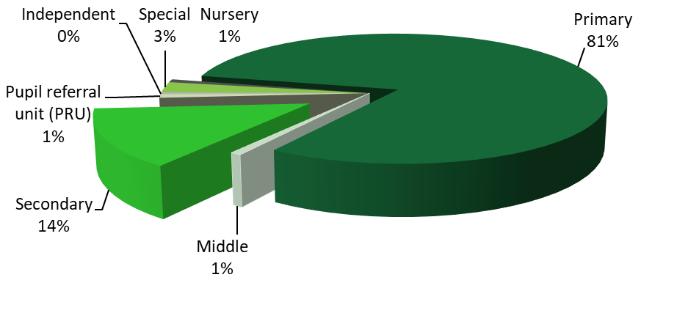
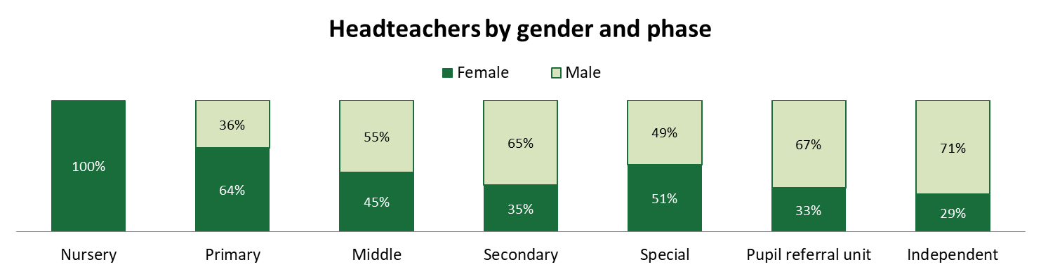
What data tells us: headteachers
Phase | Number | %
Nursery | 11 | 1
Primary | 1,176 | 81
Middle | 11 | 1
Secondary | 203 | 14
PRU | 12 | 1
Special | 38 | 3
Independent | 7 | 0
Total | 1,458 | 100
Headteachers by phase working
Based on data extracted from the Register of Education Practitioners on 1 March 2017
Notes:
The gender balance of headteachers has improved from 49.5% female in 2003 to 59.2% in 2017, which now better reflects the gender breakdown of the profession as a whole (75.4% of the school teachers in 2017 were female).
The age balance of headteachers nationally is healthy. In 2007 & 2008 37% of headteachers in Wales were over 55, compared to 21% in 2017. 27% of current headteachers are in the age range 45-49.

Slide 4
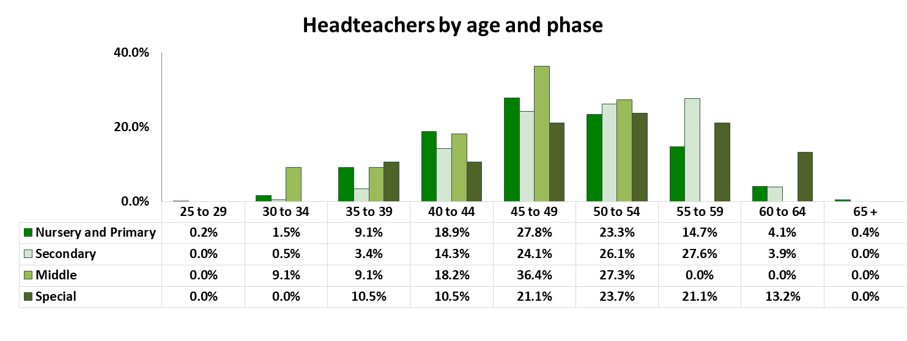
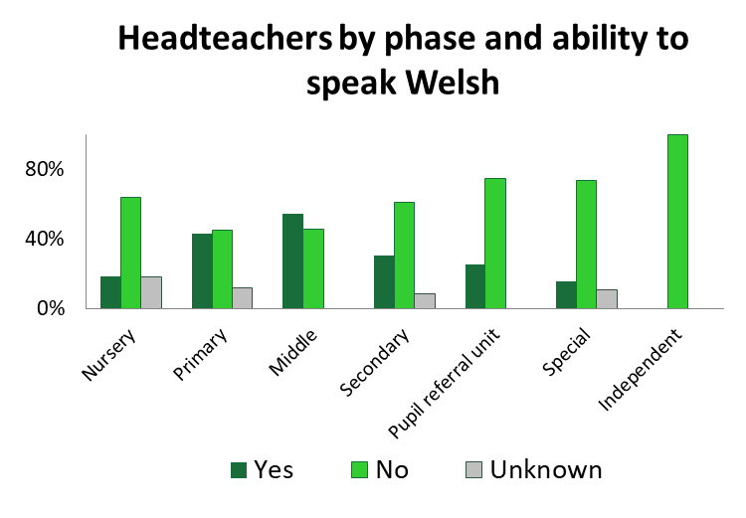
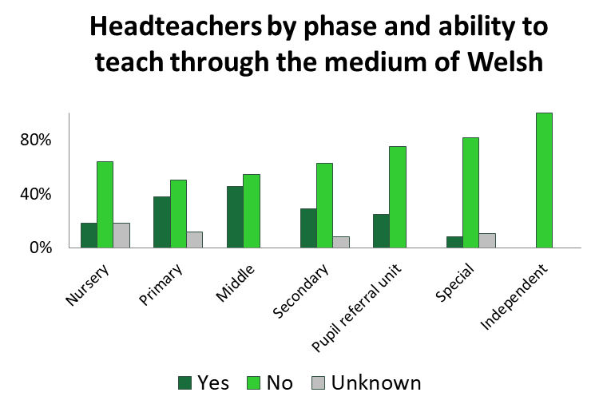
Notes:
The percentage of Welsh speaking headteachers (40.3%) is notably higher than the percentage of all registered teachers (33.3%).and deputy (35.8%) and assistant headteachers (35.7%) and considerably higher than the 19% national figure shown in the 2011 Census. This trend is mirrored when considering those headteachers who have declared that they are able to teach through the medium of Welsh (35.4%) compared to all registered teachers (27.4%) and deputy (29.5%) and assistant headteachers (30.1%).

Slide 5
Headteachers who are aged 55 and over by local authority
 | Primary 55 and over | Primary % 55 and over | Secondary 55 and over | Secondary % 55 and over | Total (all phases) 55 and over | Total % (all phases) 55 or over
Blaenau Gwent | 3 | 16.7 | 0 | 0.0 | 4 | 14.8
Bridgend | 11 | 23.4 | 2 | 28.6 | 13 | 23.2
Caerphilly | 11 | 14.7 | 3 | 25.0 | 14 | 15.7
Cardiff | 17 | 17.5 | 4 | 23.5 | 25 | 19.7
Carmarthenshire | 11 | 13.6 | 5 | 41.7 | 17 | 17.5
Ceredigion | 6 | 18.2 | 1 | 14.3 | 7 | 16.7
Conwy | 6 | 12.0 | 3 | 42.9 | 10 | 16.9
Denbighshire | 10 | 23.3 | 3 | 33.3 | 14 | 25.5
Flintshire | 10 | 14.9 | 6 | 46.2 | 17 | 20.5
Gwynedd | 13 | 17.1 | 5 | 35.7 | 18 | 19.6
Isle of Anglesey | 8 | 23.5 | 0 | 0.0 | 9 | 22.0
Merthyr Tydfil | 8 | 38.1 | 3 | 60.0 | 12 | 42.9
Monmouthshire | 7 | 24.1 | 2 | 50.0 | 9 | 26.5
Neath Port Talbot | 10 | 20.4 | 4 | 44.4 | 14 | 23.0
Newport | 8 | 22.9 | 2 | 25.0 | 12 | 26.1
Pembrokeshire | 13 | 25.5 | 2 | 25.0 | 16 | 25.8
Powys | 11 | 14.3 | 3 | 27.3 | 16 | 17.2
Rhondda Cynon Taff | 22 | 22.2 | 5 | 33.3 | 28 | 23.3
Swansea | 14 | 17.7 | 6 | 40.0 | 20 | 20.6
Torfaen | 8 | 33.3 | 3 | 42.9 | 13 | 39.4
Vale of Glamorgan | 6 | 13.6 | 2 | 28.6 | 10 | 17.5
Wrexham | 8 | 17.0 | 0 | 0.0 | 10 | 16.9
21% of headteachers in Wales were 55 or over at 1 March 2017 (18.8% primary, 31.5% secondary)

Slide 6
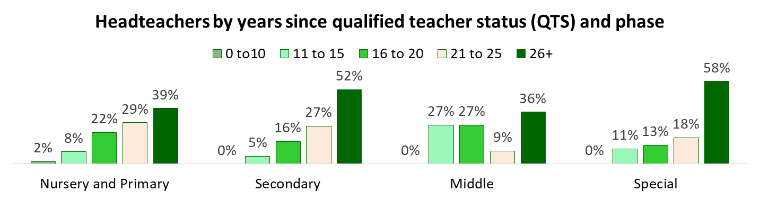
of all headteachers are
White:British
1.6% Other ethnic groups
22.3% Do not wish to be recorded or unknown
Difference by phase
Primary – 74% White: British
Secondary – 83% White: British
English, History, Mathematics, Physical Education and Welsh are the top five subjects trained (ITET) for secondary headteachers
Headteacher by phase and location of initial teacher training institution
Initial teacher training | Nursery and primary | Middle | Secondary | Special | Pupil referral unit | Independent | Total
Wales | 783 | 5 | 81 | 15 | 8 | 3 | 895
England | 160 | 0 | 44 | 5 | 3 | 1 | 213
UK | 196 | 6 | 75 | 15 | 1 | 3 | 296
Other EU countries | 2 | 0 | 0 | 0 | 0 | 0 | 2
Unknown | 46 | 0 | 3 | 3 | 0 | 0 | 52
Total | 1187 | 11 | 203 | 38 | 12 | 7 | 1458

Slide 7
Tracking headteachers, deputies, and assistants
Based on data from the Register of Education Practitioners at 1 March each year from 2008 to 2017
Number | Nursery and primary |  | Secondary |  | Special |  | Other phases including Middle, PRU and Independent |  | Total
 | Headteachers | % | Headteachers | % | Headteachers | % | Headteachers | % | Headteachers | %
Headteachers employed in the same school 2008 to 2017 | 225 | 19% | 27 | 13% | 9 | 24% | 0 | 0% | 261 | 18%
Total headteachers 1 March 17 | 1187 | 100% | 203 | 100% | 38 | 100% | 30 | 100% | 1458 | 100%
Number | Nursery and primary |  | Secondary |  | Special |  | Other phases including Middle, PRU and Independent |  | Total
 | Deputy headteachers | % | Deputy headteachers | % | Deputy headteachers | % | Deputy headteachers | % | Deputy headteachers | %
Deputy headteachers employed in the same school 2008 to 2017 | 105 | 13% | 24 | 12% | 5 | 16% | 0 | 0% | 134 | 12%
Total deputy headteachers 1 March 17 | 819 | 100% | 201 | 100% | 32 | 100% | 24 | 100% | 1076 | 100%
Number | Nursery and primary |  | Secondary |  | Special |  | Other phases including Middle, PRU and Independent |  | Total
 | Assistant headteachers | % | Assistant headteachers | % | Assistant headteachers | % | Assistant headteachers | % | Assistant headteachers | %
Assistant headteachers employed in the same school from 2008 to 2017 | 9 | 6% | 43 | 11% | 1 | 3% | 0 | 0% | 53 | 9%
Total assistant headteachers 1 March 2017 | 153 | 100% | 381 | 100% | 38 | 100% | 16 | 100% | 588 | 100%
Notes:
Need to consider: based on first employment on registered and name of school which may have changed due to school mergers.

Slide 8
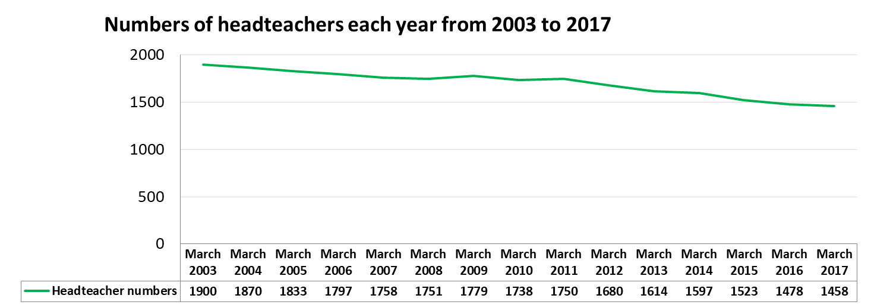
What data tells us: headteacher trends
Influential factors:
reduction in the number of schools in Wales;
increase in middle schools;
increase in federated schools and headteachers covering more than one school e.g. rural areas and interim arrangements during recruitment
Notes:
Succession planning is important as the overall number of headteachers in Wales is decreasing
Increase federated school/reduced number of schools – as at March 2017 there were 60 (4.1%) headteachers registered with the EWC who were headteacher of more than one school

Slide 9
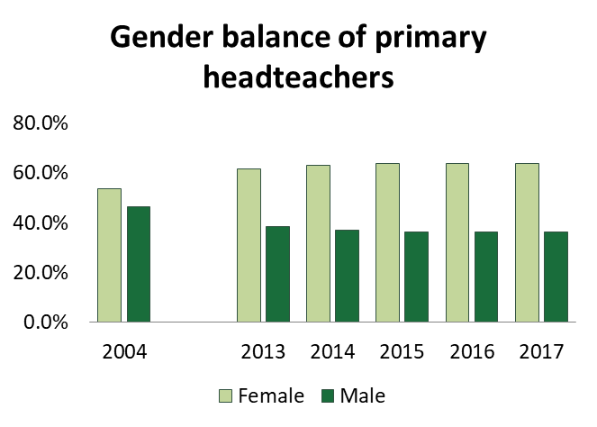
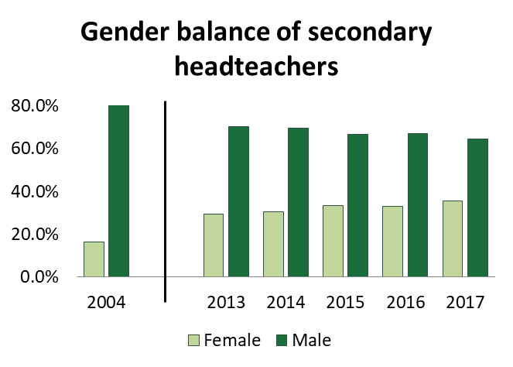
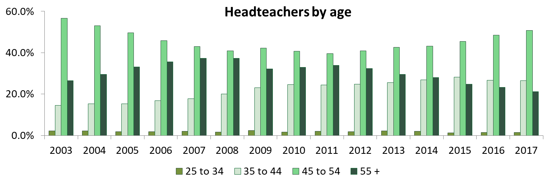
Notes:
75% of school teachers are female

Slide 10
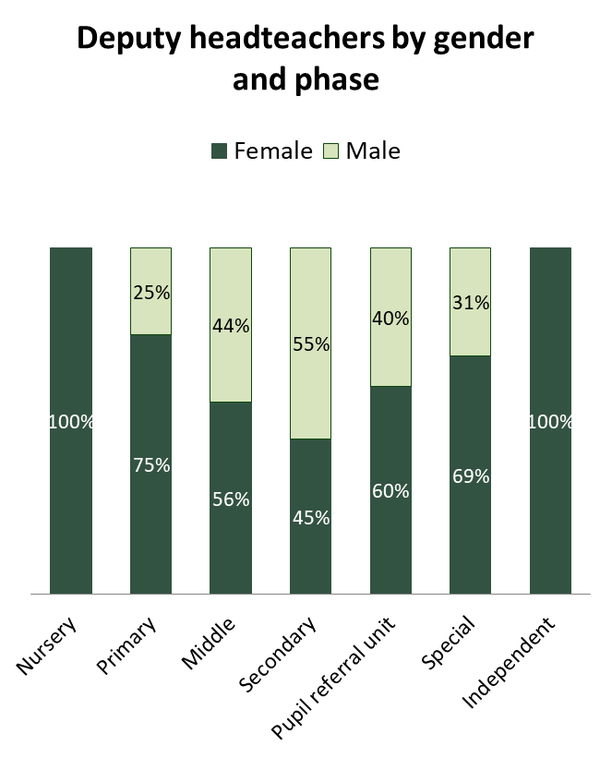
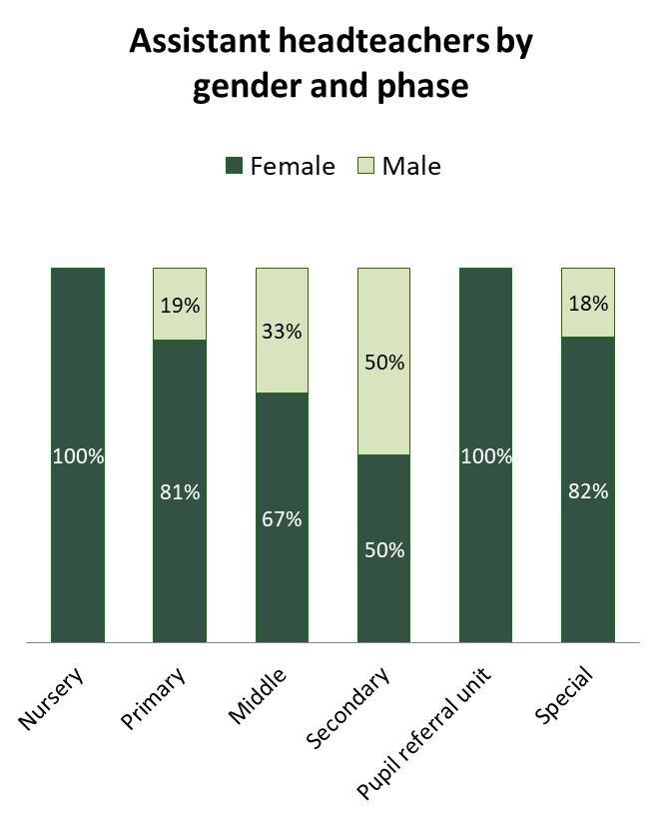
Deputy and assistant headteachers

Slide 11
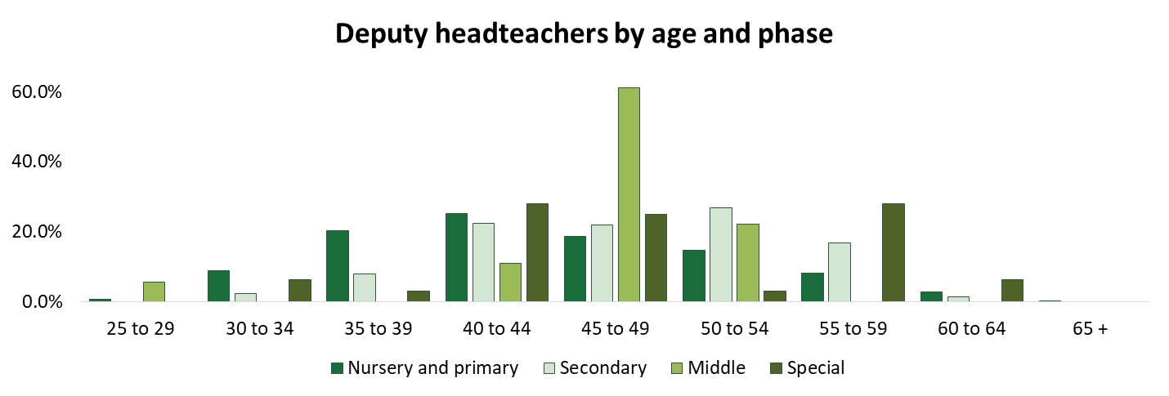
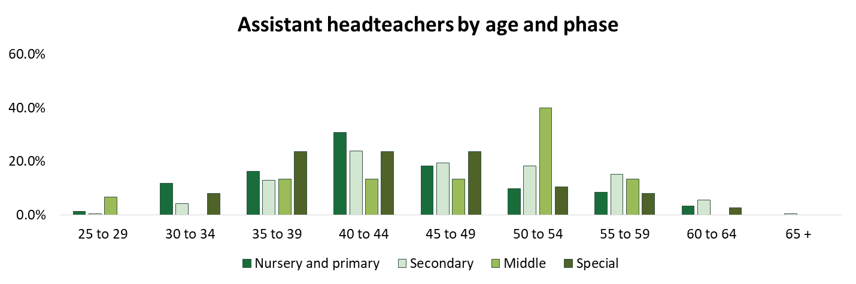

Slide 12
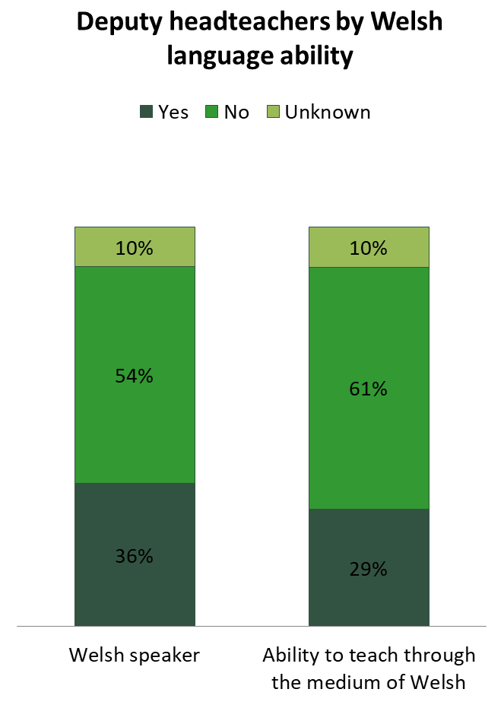


Slide 13
Fitness to practise
Number of cases | Phase working
 | Primary | Secondary | Special | Total
Headteacher | 44 | 12 | 3 | 59
Deputy headteacher | 16 | 5 | 1 | 22
Assistant headteacher | 3 | 2 | 0 | 5
Total | 63 | 19 | 4 | 86
Concluded cases from 2000 to November 2017. The above account for 16.5% of all cases involving those registered in the school teacher category.
Types of behaviour include:
  combination of conduct issues
  failing to comply with procedures
  false declarations and forged documents
  theft of funds from workplace

Slide 14
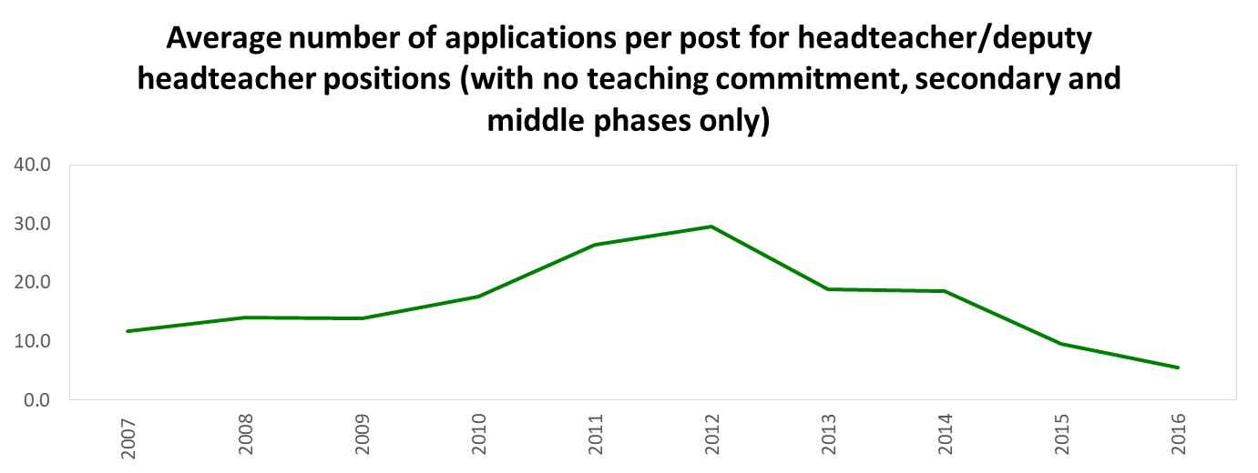
Recruitment and retention
Average number of applications | 2014 | 2015 | 2016
Headteacher or deputy headteacher | 18.5 | 9.6 | 5.6
Average number of applications for headteacher or deputy headteacher roles have decreased between 2014 and 2016 (-12.9). On average there were 5.6 applications for headteacher or deputy headteacher posts in 2016
Source: Stats Wales: Pupil Level Annual School Census (PLASC), Welsh Government
Notes:
Variation between local authorities/consortia.
PLASC for secondary and middle phases only.

Slide 15
National Professional Qualification for Headship
NPQH became a requirement for new headteachers in Wales in 2005. The figures are based on registered school teachers at 1 March 2017.
Calendar year of award of NPQH | Number of school teachers registered as at 1 March 2017 with NPQH
1999 | 12
2000 | 28
2001 | 48
2002 | 49
2003 | 160
2004 | 125
2005 | 150
2006 | 122
2007 | 130
2008 | 126
2009 | 156
2010 | 137
2011 | 208
2012 | 67
2013 | 73
2014 | 68
2015 | 108
2016 | 118
Total | 1885
 | Nursery and primary | Middle | Secondary | Special | Pupil referral unit | Independent | Total
Headteachers with NPQH | 857 | 9 | 164 | 26 | 2 | 2 | 1060
Headteachers without NPQH | 330 | 2 | 39 | 12 | 10 | 5 | 398
Total | 1187 | 11 | 203 | 38 | 12 | 7 | 1458
 | Year of NPQH award |  |  |  |  | Total
 | 1996 - 2000 | 2001 - 2005 | 2006 - 2010 | 2011 - 2015 | 2015 +
Deputy headteacher | 3 | 68 | 98 | 73 | 77 | 319
Assistant headteacher | 0 | 19 | 37 | 22 | 15 | 93
Head of year, head of department or teacher | 1 | 60 | 52 | 41 | 32 | 186
Others in and out of service | 12 | 105 | 77 | 26 | 7 | 227
Total | 16 | 252 | 264 | 162 | 131 | 825
NPQH may have been awarded in Wales or England.
Notes:
62% of those with NPQH (not including headteachers) are female

Slide 16
NPQH | Nursery and Primary | Middle | Secondary | Special | Pupil referral unit | Total
Deputy headteacher | 190 | 10 | 109 | 10 | 0 | 319
25 to 29 | 1 | 0 | 0 | 0 | 0 | 1
30 to 34 | 3 | 0 | 1 | 1 | 0 | 5
35 to 39 | 31 | 0 | 5 | 1 | 0 | 37
40 to 44 | 43 | 0 | 21 | 1 | 0 | 65
45 to 49 | 49 | 7 | 29 | 3 | 0 | 88
50 to 54 | 37 | 3 | 34 | 1 | 0 | 75
55 to 59 | 15 | 0 | 18 | 3 | 0 | 36
60 to 64 | 11 | 0 | 1 | 0 | 0 | 12
Assistant headteacher | 24 | 2 | 62 | 4 | 1 | 93
30 to 34 | 1 | 0 | 0 | 0 | 0 | 1
35 to 39 | 3 | 0 | 3 | 1 | 0 | 7
40 to 44 | 5 | 1 | 11 | 0 | 0 | 17
45 to 49 | 7 | 0 | 11 | 2 | 0 | 20
50 to 54 | 4 | 1 | 22 | 1 | 0 | 28
55 to 59 | 1 | 0 | 8 | 0 | 1 | 10
60 to 64 | 3 | 0 | 7 | 0 | 0 | 10
Total | 214 | 12 | 171 | 14 | 1 | 412
Numbers of years between QTS and NPQH | Nursery and Primary | Secondary
0 to 10 | 21% | 8%
11 to 15 | 38% | 29%
16 to 20 | 25% | 33%
21 to 25 | 12% | 22%
26 to 30 | 5% | 8%
Total | 100% | 100%

Slide 17
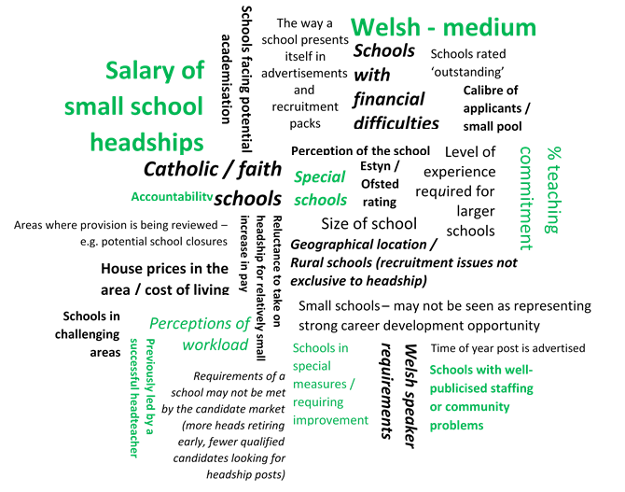
Reasons some headteacher posts are more difficult to fill

Slide 18
What headteachers said - findings from surveys and interviews
Headteachers enjoy being able to make a difference, seeing pupils achieve, privileged to be in role and want to continue
Workload, hours (headteachers and their staff)
School funding
Rapid pace of change in the Welsh education system
Managerial, administrative, technical, other tasks deflect from core purpose and disincentive to becoming a headteacher, deputy, assistant
Layers of accountability. Challenge welcomed, but duplication / inconsistency
  WG, Estyn, consortia, local authorities, governors
  Managing the expectations of parents
  Strength, composition and engagement levels of governing body
  Perceptions of job security – ‘premier league football manager mentality’
Erosion of local authority services
Improve professional development for headteachers and deputies and make more consistent across Wales

Slide 19
Comments from headteachers
Resolve / improve issues raised on previous slide
Improve CPD arrangements for headteachers and deputies
  Review and improve NPQH
  Support for the period between NPQH to taking on a headship (currency)
  ‘Menu’ of quality assured courses deemed suitable for headteachers
  Induction for new headteachers
    Structured, formal mentoring arrangements for new headteachers and deputies – independent of accountability systems
    Opportunities for networking / headteacher away day
  Ongoing CPD for headteachers
    Structured arrangements to view different leadership styles and schools
    Collaboration between schools that is not forced
    Opportunities for secondments to gain experience elsewhere
Thank you to all who have participated in our research

Slide 20
Insights from other countries
Similar recruitment challenges in some countries
Qualification requirements:
  NPQH withdrawn as a requirement in England
  Not a requirement in Northern Ireland
  Headteacher qualification mandatory in Scotland from 2019
Leadership body: NCTL (England) and SCEL (Scotland)
Some good professional development examples in other countries
South Australia | New school and preschool leaders are offered the opportunity to be paired with an experienced or recently retired leader as a mentor as part of the Leader Advisor Programme. The leader advisor provides support and guidance in the first two terms of a new leader’s role. After the first two terms, the new leader will complete the Graduate Diploma of Strategic Leadership. The diploma is offered by the Department for Education and Child Development free of charge to all newly appointed government school and preschool leaders.

Slide 21
Policy recommendations
Tackle issues raised
  Barriers to being head
  Research to identify gender and ethnicity barriers to headship
  Support once in post
Monitor the age group 45-54, geography, phase
Critically evaluate NPQH
Targeted and effective recruitment campaigns, including headteachers
Learn from other countries
Look forwards e.g.
  School funding, new curriculum, devolved pay and conditions, Welsh language policy, rise of federated schools, ALN Bill, new professional standards
Leadership Academy
  Effective programmes (entry, new, serving)

Slide 22
Contact us/collaborate with us
Telephone 029 2046 0099
E-mail research@ewc.wales or statistics@ewc.wales
Website www.ewc.wales
Twitter @ewc_cga
E-newsletter Subscribe from website

