Slide 1


Slide 2
Methodoleg Methodology
Ymatebwyr
Respondents
8 grŵp wedi’u harolygu
8 groups surveyed
Dyluniad yr arolwg
Survey design
Holiaduron wedi’u datblygu a’u treialu
Questionnairesdeveloped and piloted
Amserlen
Timescale
Cyfnod yr arolwg - Ionawr i Mai 2021
Survey period – January to May 2021
Dull
Method
Cyfathrebu
Communication
Ar-lein trwy wefan CGA
Online via EWC website
Partnership plan
Cynllun partneriaeth

Slide 3
Adrannau’r arolwg Survey topics
Rôl a gyrfa
Role and career
Patrymau gweithio a baich gwaith
Working patterns and workload
Lles
Well-being
Dysgu cyfunol ac o bell
Blended and remote learning
Cwricwlwm newydd
New curriculum
Dysgu proffesiynol
Professional learning

Slide 4
Ymatebwyr | Nifer/No. | % | Respondents
Gweithiwr cymorth dysgu ysgol | 3,424 | 12.5 | School learning support worker
Athro ysgol | 3,346 | 12.7 | School teacher
Athrawon AB | 1,722 | 34.4 | FE teacher
Arweinydd ysgol | 758 | 23.8 | School leader
Ymarferydd dysgu seiliedig ar waith | 582 | 29.5 | Work-based learning practitioner
Gweithiwr cymorth dysgu AB | 580 | 23.7 | FE learning support worker
Gweithiwr ieuenctid | 163 | 48.5 | Youth worker
Gweithiwr cymorth ieuenctid | 58 | 13.2 | Youth support worker

Slide 5
Rôl a gyrfa Role and career
Gyrfa dros y 3 blynedd nesaf
Career over the next 3 years
Parhau i ddatblygu / cryfhau arfer
Continuing to develop/strengthen practice
Mentora neu gefnogi cydweithwyr llai profiadol
Mentor or support less experienced colleagues
Symud i lefel / rôl uwch
Moving to a higher level/more senior role
15.9% ST, 7.9% SL
Gadael y proffesiwn
Leaving the profession
10.7% SL
retiring
ymddeol
  60 % -75%
  ymatebwyr / respondents
Yn debyg i arolwg 2016/17 Similar to 2016/17 survey

Slide 6
Patrymau gwaith a baich gwaith
Working patterns and workload
Oriau a dreuliwyd ar:
Gweithgareddau gwaith craidd, sylw uchel ar weinyddiaeth a gwaith papur
Hours spent on:
Core work activities, admin and paperwork featured highly
56.0
Athro ysgol /School teacher
54.0
Arweinydd ysgol/ School leader
50.5
Athro AB / FE teacher
Oriau cyfartalog yr wythnos (llawn amser) /
Average hours per week (full time)
43.5
Ymarferydd dysgu seiliedig ar waith/ WBL practitioner
43.1
Gweithiwr cymorth dysgu ysgol /School learning support worker
40.8
Gweithiwr cymorth dysgu AB/FE learning support worker
Yn debyg i arolwg 2016/17
Similar to 2016/17 survey
39.6
Ymarferydd gwaith ieuenctid/ Youth work practitioner

Slide 7
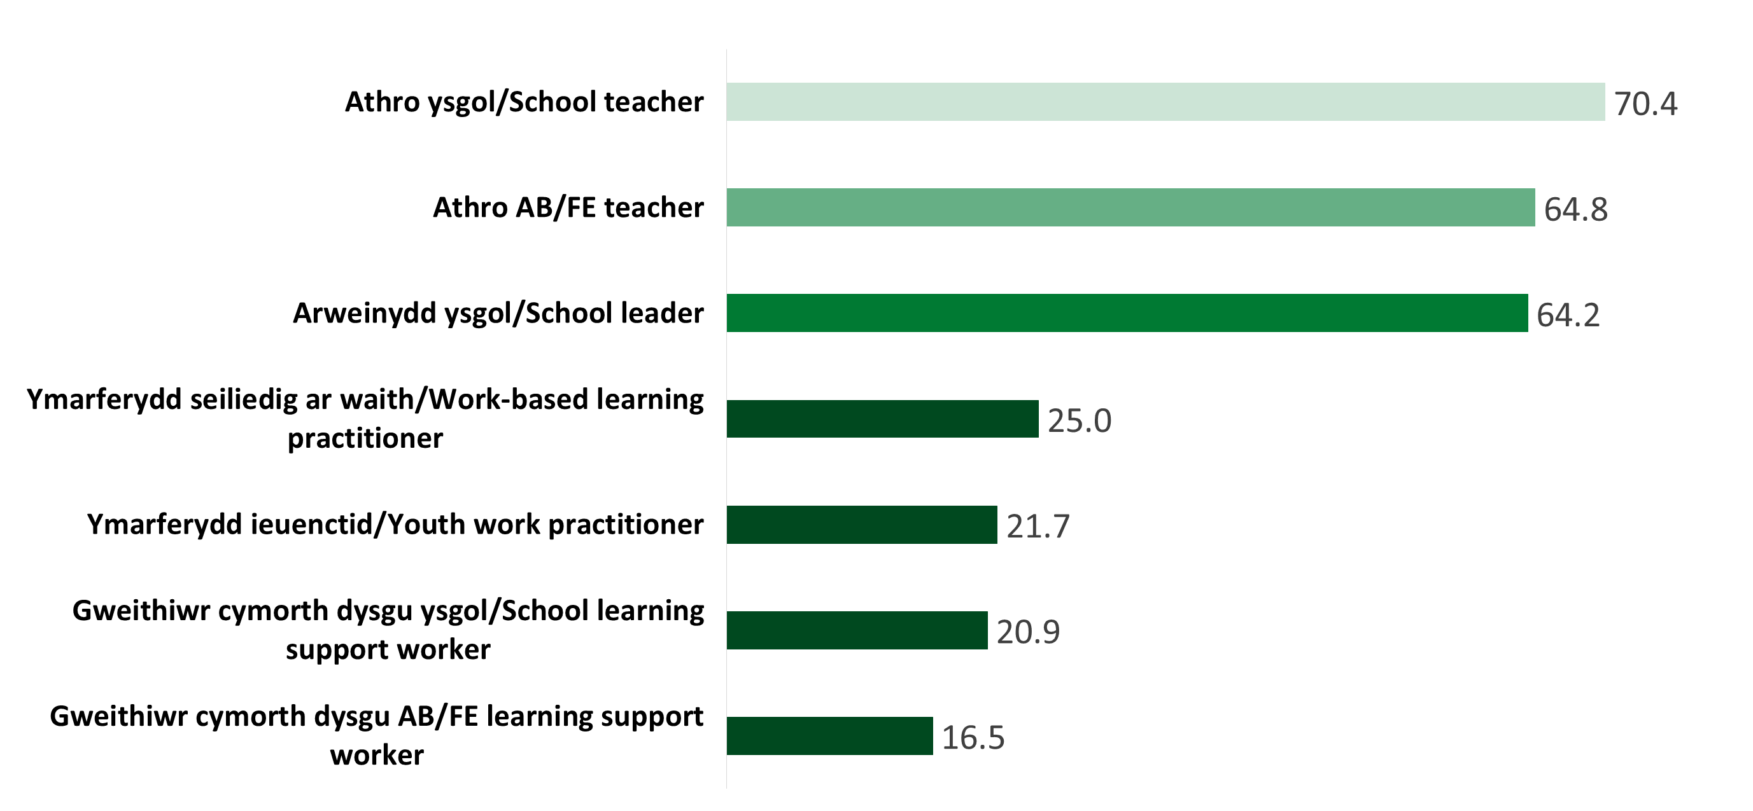
Anghytuno/Anghytuno’n gryf eu bod yn gallu rheoli baich gwaith
Disagreed/strongly disagreed they were able to manage workload
%

Slide 8
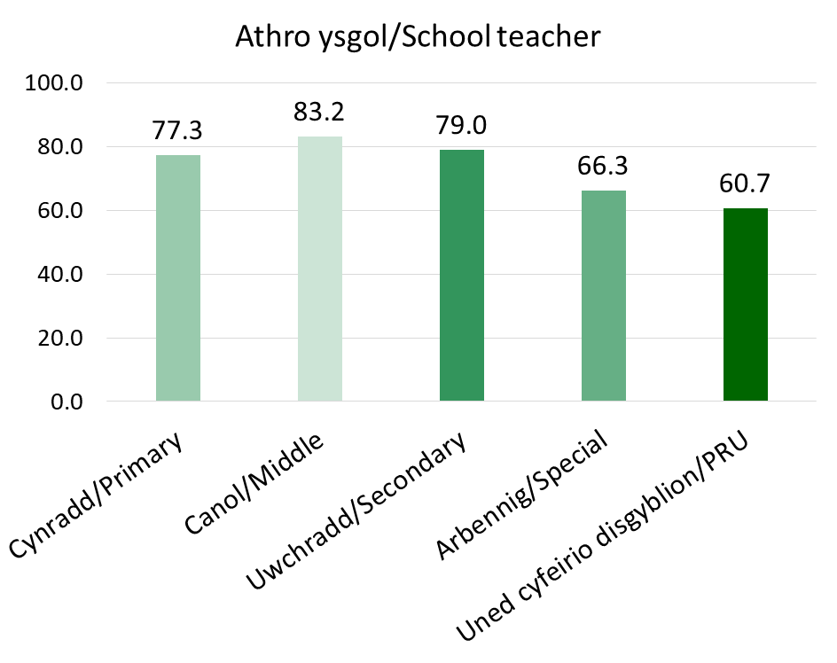
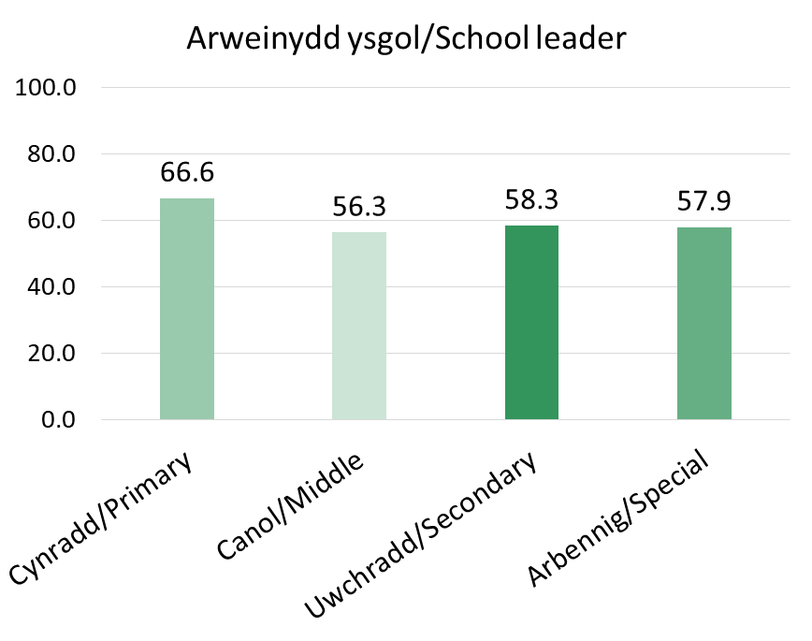
Anghytuno/Anghytuno’n gryf eu bod yn gallu rheoli baich gwaith yn ôl cyflogaeth
Disagreed/strongly disagreed they were able to manage workload by phase
%
%

Slide 9






Pwysau llwyth gwaith
Workload pressures
Wedi'i effeithio ar allu i reoli back gwaith Impacted on ability to manage workload
Gweinyddiaeth / gwaith papur (pob un)
Administration / paperwork (all)
Cefnogaeth ychwanegol i ddysgwyr (pob un)
Additional support for learners (all)
TGCh (ysgol ac AB)
ICT (school & FE)
Heriau cyflwyno dysgu o bell / cyfunol
Challenges of remote/blended learning (all)
Maint dosbarthiadau neu llwyth achosion (ysgol a WBLP)
Class size or caseload (school & WBLP)
Amser ar gael am CPA (athrawon)
Time available for PPA (teachers)

Slide 10
Awgrymiadau ymarferol i lleihau llwyth gwaith
Lleihau oriau cyswllt / maint dosbarthiadau (athrawon), llwyth achosion (WBLP, YWP) Mwy o oriau gwaith â thâl (LSW) Lefelau staff uwch (pob un) Llai o systemau adrodd gweinyddu / symleiddio (pob un) Gwella mynediad i'r dechnoleg a'r hyfforddiant priodol (pob un) Amser paratoi adnoddau / cronfa ganolog (athrawon)
Practical suggestions for reducing workload
Reduce contact hours/class size (teachers), caseload (WBLP, YWP) Increased paid working hours (LSW) Increased staffing levels (all) Less administration/streamline reporting systems (all) Improve access to the appropriate technology and training (all) Resources preparation time/centralised bank (teachers)
Pe bai mwy o amser gen i, faswn i’n ei dreulio’n
Cynllunio a pharatoi Trafod gwaith gyda gyda chydweithwyr / dysgwyr Paratoi am y cwricwlwm newydd
If I had more time I would use it on
Planning and preparation Discussing work with colleagues/learners Preparing for new curriculum

Slide 11
Cwricwlwm ysgol newydd
New school curriculum
Yn barod i gyflawni’r cwricwlwm newydd?
Prepared to deliver the new curriculum?
Cytunodd 51.8% o ymatebwyr arweinwyr ysgol eu bod yn barod
51.8% of school leaders respondents agreed they were prepared
Cytunodd 38.4% ymatebwyr arweinwyr ysgol fod eu cydweithwyr/staff yn barod
38.4% of school leader respondents agreed their colleagues/staff were prepared
Cytunodd 33.3% ymatebwyr athrawon ysgol yn barod
33.3% of school teacher respondents agreed they were prepared

Slide 12
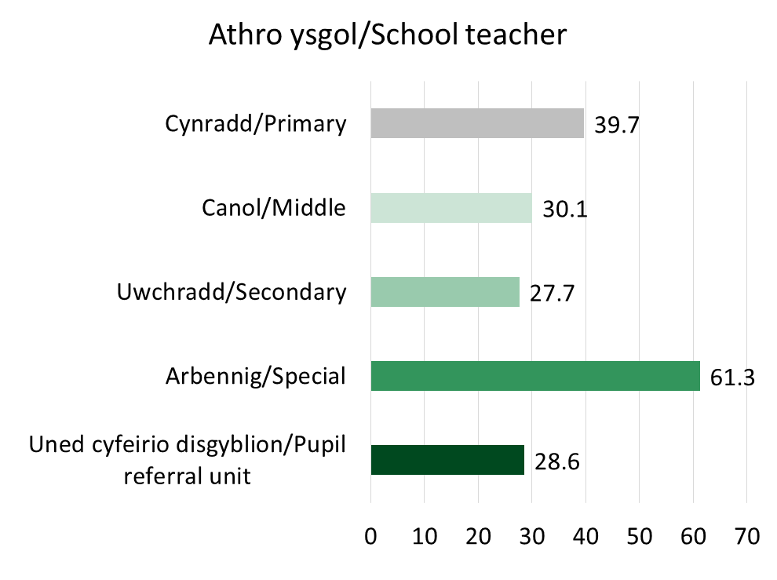
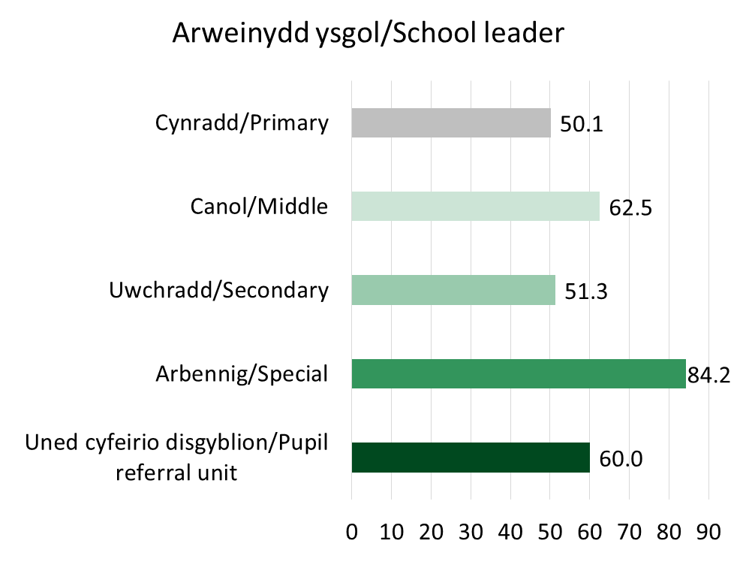
Cytuno/Cytuno’n gryf eu bod yn barod i gyflwyno’r cwricwlwm newydd yn ôl cyfnod
Agreed/strongly agreed that they were prepared to deliver the new curriculum by phase
%
%

Slide 13
Cwricwlwm ysgol newydd
New school curriculum
Beth fyddai'n eich helpu i deimlo'n fwy parod?
mwy o arweiniad a hyfforddiant i'w darparu
mae angen mwy o amser
What would help you feel more prepared?
more guidance and training to be provided
more time required
opportunities to discuss with colleagues and other schools
prepare resources
paratoi adnoddau
oedi gweithredu
eglurhad ar asesiad
cyfleoedd i drafod gyda chydweithwyr ac ysgolion eraill
delay implementation
clarification on assessment

Slide 14
Lles
Wellbeing
Roedd pandemig COVID-19 wedi effeithio ar les:
The COVID-19 pandemic had impacted on wellbeing:
Pryder am eu hiechyd eu hunain a’r rhai sy’n agos atynt
Concern about their own health and those close to them
ST 75.8% - YWP 69.7%
ST 75.8% - YWP 69.7%
Arferion addysgu / gweithio / arwain
Teaching/working/leading practices
SL 82.7%, FET 75.2%, ST 72.9%
SL 82.7%, FET 75.2%, ST 72.9%
Lles a diogelwch yn y gweithle
Well-being and safety at work
ST 69.1%, FET 68.5%, FSW 66.8%
ST 69.1%, FET 68.5%, FSW 66.8%
Rheoli lles trwy
Cyrsiau hyffordiant
Gweithgareddau/ diwrnodau lles
Well-being managed by
Training courses
Well-being days or activities
Counselling
Cwnsela
Cytunodd mwyafrif y grwpiau eu bod yn teimlo'n ddiogel yn eu swydd (yn ystod y 12 mis diwethaf / yn ystod COVID-19)
Most groups agreed they felt secure in their job (during the last 12 months/during-COVID-19)

Slide 15
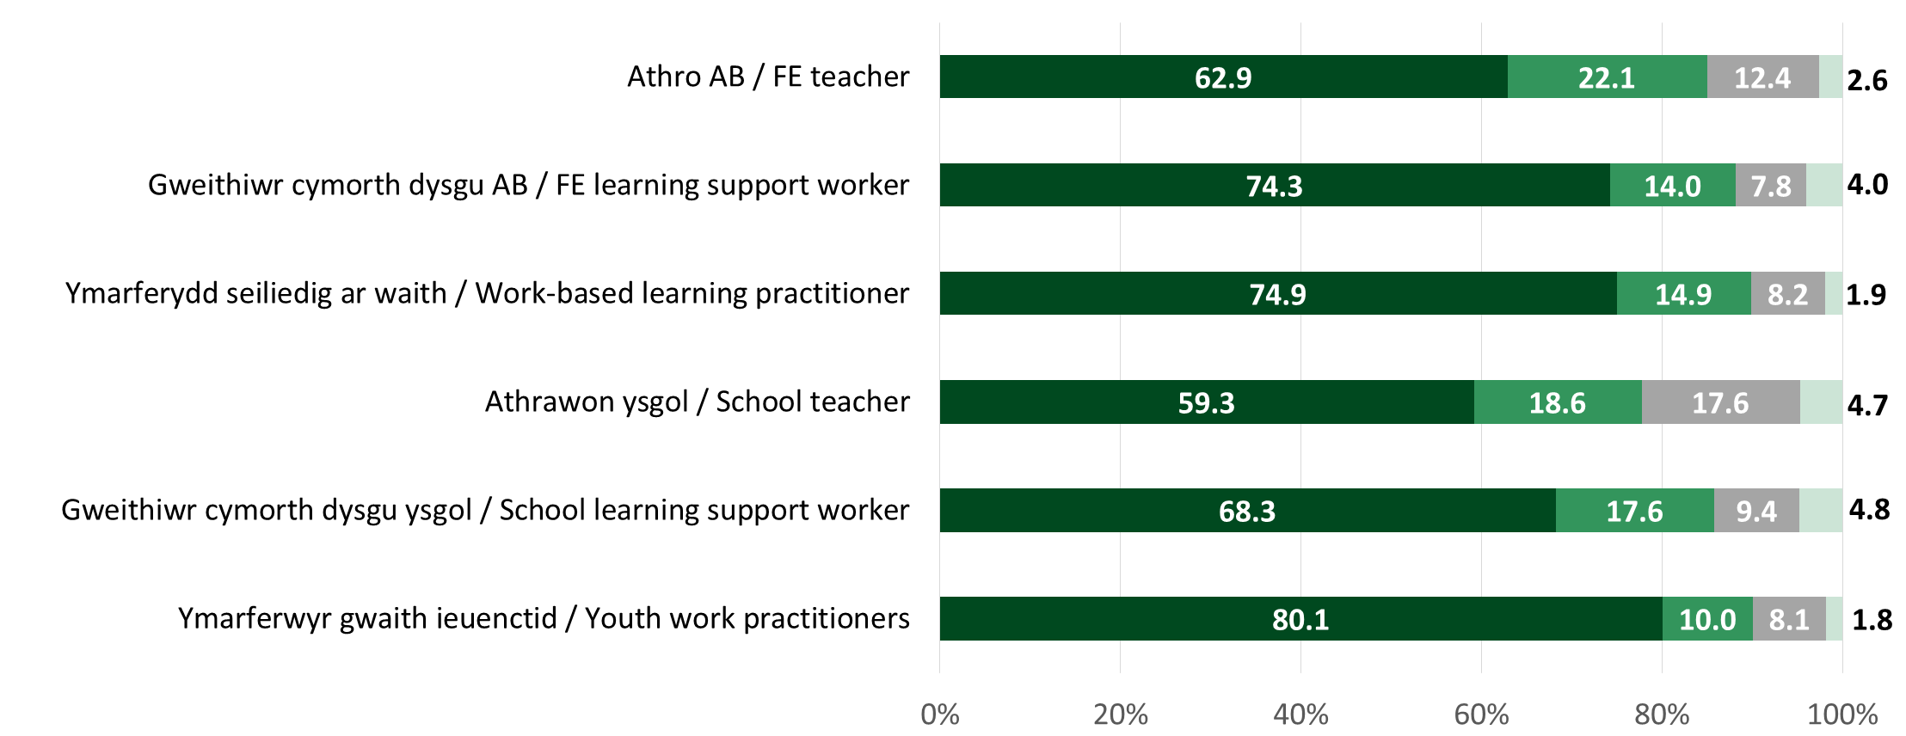
Lles
Wellbeing
Cefnogaeth gan eu cyflogwr - A yw pryderon yn cael eu cymryd o ddifrif ac a fydd cyflogwr yn gwneud yr hyn a allant i helpu?
Supported by their employer - Are concerns taken seriously and will employer do what they can to help?

Slide 16
Dysgu cyfunol ac o bell Blended and digital learning
Buddion i barhau â dysgu digidol/dysgu cyfunol ar ôl COVID-19
Benefits of continuing with digital/blended learning post COVID-19
Hyfforddiant a chefnogaeth ychwanegol ar gael – yn fwy buddiol
Additional training and support available – more beneficial
Angen technoleg ac offer ar y mwyafrif - soniwyd am ddibynadwyedd
Most had technology and equipment needed – reliability issues mentioned
Hyder wrth ddarparu dysgu digidol / cyfunol – eithaf uchel. Cyn COVID-19 – ymateb cymysg
Confidence in delivering digital/blended learning – fairly high. Pre COVID-19 - mixed response

Slide 17
Dysgu proffesiynol
Professional learning
Cyrsiau / courses
95% SL - 74% SLSW
Defnyddio technoleg newydd / use of new technologies
80% FET – 47% SLSW
Gofyniad DPP 30 awr (cyfwerth ag amser llawn) ar gyfer FET (cytundeb cenedlaethol): 55.1% wedi cwblhau 30 awr neu fwy y 12 mis diwethaf.
30 hour (FTE) CPD requirement for FET (national contract): 55.1% completed 30 hours or more last 12 months.
Mewn cymhariaeth/in comparison: | %
SL | 65.0
FET | 55.1
WBLP | 52.1
YWP | 48.9
FELSW | 43.4
ST | 33.1
SLSW | 32.7
Yn debyg i arolwg 2016/17
Similar to 2016/17 survey

Slide 18
Dysgu proffesiynol
Professional learning
Gwrthdaro â’ch gwaith/dim digon o amser
Conflict with work/not enough time
SL 65% - 29% SLSW
Cost (sector ysgol)
Cost (school sector)
ST 39%, SLSW 33%, SL 25%
Ymrwymiadau personol, cartref, teulu (sector ôl 16)
Home, family, personal commitments (post-16 sector)
FET 30%, FELSW 28%, WBLP 25%
Onid oedd unrhyw rwystrau a bod eu hanghenion dysgu proffesiynol dros y 12 mis diwethaf wedi'u diwallu'n llawn:
No barriers and that their professional learning needs over the last 12 months had been fully met:
42.6% WBLP
41.2% FELSW
35.7% YWP
28.5% SL
28.4% SLSW
27.9% FET
17.9% ST
Rhwystrau/Barriers

Slide 19
Dysgu proffesiynol Professional learning
Croesewir datblygiad pellach mewn… Further development welcomed in…
TGCh a datblygu digidol
ICT & digital development
Iechyd meddwl/lles
Mental health/well-being
Gwybodaeth pwnc/ ddiwydiant
Subject/industry knowledge
Rheolaeth / arweinyddiaeth
Management/
leadership
Cwricwlwm newydd
New curriculum
ADY / rheoli ymddygiad
ALN/Behaviour management
Sector
Pob
All
AB
FE
DSW
WBL
Ysgol
School

Slide 20
Crynodeb
Summary
Datblygiad a dilyniant gyrfa parhaus yn flaenoriaeth
Gyda mwy o arweiniad, buddion ychwanegol i barhau â dysgu cyfunol / digidol gyda mwy o arweiniad
Cefnogaeth iechyd a lles meddwl gan gyflogwyr mwyafrif yn teimlo’n ddiogel yn eu swyddi yn ystod y pandemig
Effaith COVID-19 ar les, ac arferion gwaith a rhai pryderon ynghylch iechyd a diogelwch
Awydd ar draws pob grŵp i wella neu ddatblygu eu sgiliau Cymraeg ymhellach
Mwy o gefnogaeth ac amser o gymorth i baratoi ar gyfer y cwricwlwm newydd
Pryderon ynghylch baich gwaith - y tu hwnt i oriau cytundebol, gormod o weinyddiaeth, lefelau staffio
Diffyg amser / gwrthdaro â gwaith sy'n atal mynediad i ddysgu proffesiynol
With added guidance, benefits to continuing with blended / digital learning
Continuing career development and progression a priority
COVID-19 impact on wellbeing and working practices and some health and safety concerns
Support from employers for mental health and wellbeing with most having felt secure in their jobs during pandemic
More support and time would be welcomed in preparation for the new curriculum
Lack of time / conflict with work preventing access to professional learning
Workload concerns – exceeding contracted hours, excess administration, staffing levels
A desire across all groups to improve or further develop their Welsh language skills

Slide 21
Differences across registrant groups
Gwahaniaethau ar draws grwpiau cofrestru
Rheoli baich gwaith yn fwy o broblem ST, SL, FET
mwy o bryderon gan WBL and YWP ynghylch diogelwch eu swydd
ST a SL yn llai cadarnhaol o ran y cymorth iechyd a lles meddwl a gynigwyd
FE a WBL yn hyderus wrth ddarparu dysgu cyfunol / digidol cyn COVID-19
Hygyrchedd a dibynadwyedd TGCh yn fwy o broblem i LSW
Ni all ddysgu o bell gymryd lle gwaith ieuenctid wyneb yn wyneb
Cost yn fwy o rwystr i ddysgu proffesiynol i ST, SLSW, SL
Managing workload more of an issue for ST, SL, FET
FE and WBL more confident in delivering blended/digital learning pre COVID-19
WBL and YWP more concerns over their job security
ST and SL less positive regarding mental health and well-being support on offer
Access and reliability ICT more of an issue for LSW
Remote learning not a substitute face to face YW
Cost more of a barrier to professional learning for ST, SLSW, SL

Slide 22

Cwestiynau
Questions

